Slide 1

Developing a Smartphone App for Local Events
Connecting people to local experiences has never been easier with a well-designed smartphone app. In this presentation, we'll explore the key steps to creating an engaging and profitable event app tailored to your community.
E.christopher (191911005)

Slide 2
Understanding the Local Event Landscape
Analyze Event Trends
Identify Unmet Needs
Research the types of events, their frequency, and audience preferences in your area. This data will guide your app features.
Discover gaps in the current event discovery and planning process that your app can solve for local attendees.

Slide 3
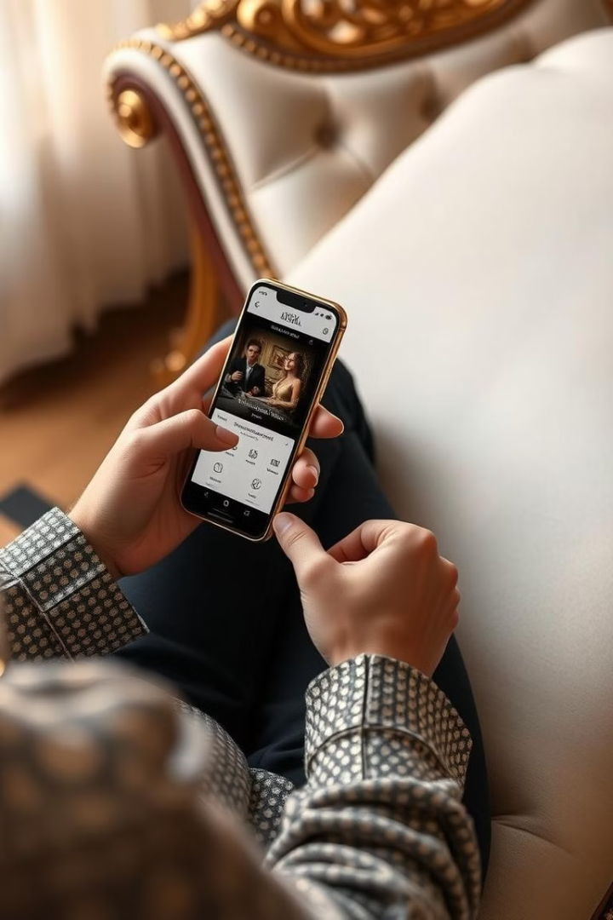
Key Features for a Successful Event App
1
Event Listings
2
Event Reminders
Provide a comprehensive calendar of upcoming local events with detailed information, photos, and ticketing links.
Send push notifications to users about events they've favorited or events near their location.
3
Social Sharing
Allow users to easily share events with friends and engage with the local community.

Slide 4

Engaging the Local Community
Partner with Event Organizers
Highlight Local Businesses
Encourage User-Generated Content
Feature nearby restaurants, shops, and other businesses that complement the event experience.
Collaborate with local event hosts to promote their events and offer exclusive app-only content.
Invite attendees to share photos and reviews, building a sense of community around the app.

Slide 5
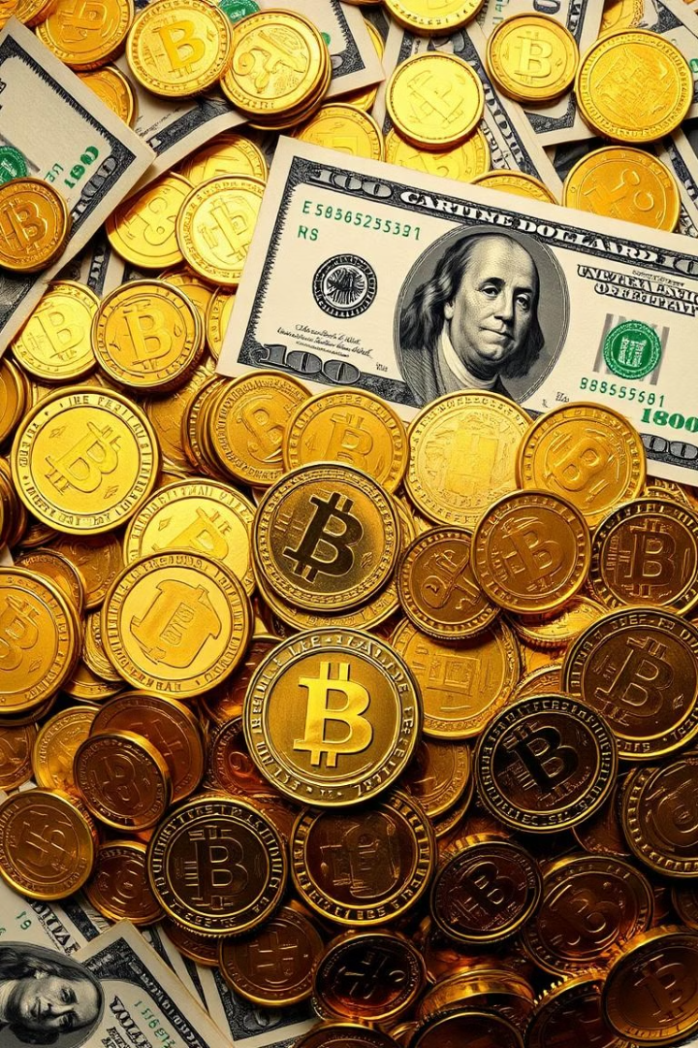



Monetization Strategies for Event Apps
Sponsored Listings
Charge event organizers to promote their events with premium placement and features.
Ticket Sales
Integrate a secure ticketing platform to earn a commission on event ticket purchases.
In-App Purchases
Offer premium features, event merchandise, or other digital goods for users to purchase.

Slide 6

Leveraging Geolocation and Beacons
Geolocation
Personalization
Use GPS to surface nearby events and provide location-based recommendations to users.
Leverage location data to personalize the user experience and suggest events based on their interests and habits.
1
2
3
Beacons
Place Bluetooth beacons at event venues to trigger push notifications and deliver hyper-targeted content.

Slide 7
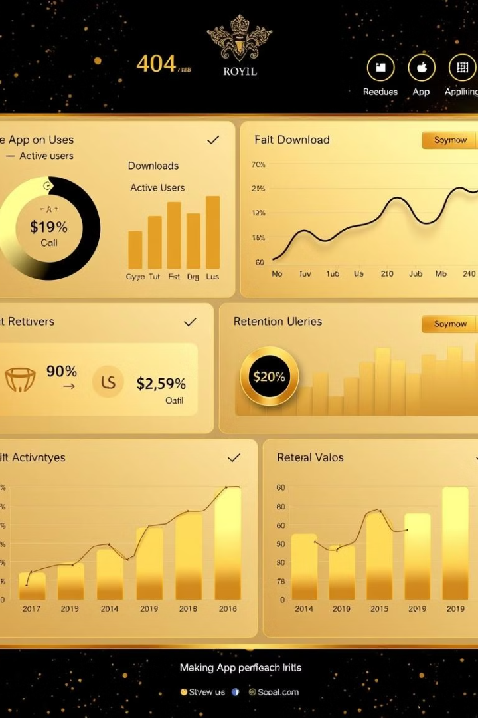
Measuring App Performance and User Engagement
15K
Downloads
Track the overall user base and monitor acquisition trends over time.
8.2%
Retention Rate
Analyze how often users return to the app and engage with its features.
4.1
Avg. Rating
Monitor user reviews and ratings to identify areas for improvement.

Slide 8
Scaling the App to New Markets
Identify Expansion Opportunities
1
Analyze event data and user trends in nearby cities or regions with similar demographics.
Localize the Experience
2
Customize the app's content, features, and branding to cater to the unique needs of each new market.
Leverage Partnerships
3
Collaborate with local event organizers, businesses, and influencers to build a strong presence in the new market.

